Slide 1
Smart Contracts and Rationality
PhD Defense
Aarhus University
Nikolaj Ignatieff Schwartzbach

Slide 2
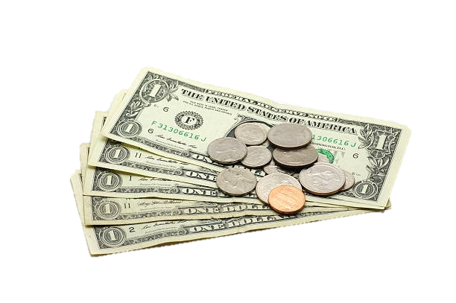
Nibbles
Whiskers

Slide 3
A Fundamental Problem

Slide 4
Publications
ITC’21
More Communication Lower Bounds for Information-Theoretic MPC
Ivan Damgård, Boyang Li, and Nikolaj I. Schwartzbach
ICBC’21
An Incentive-Compatible Smart Contract for Decentralized Commerce
Nikolaj I. Schwartzbach
ITCS’23
PPP-Completeness and Extremal Combinatorics
Romain Bourneuf, Lukáš Folwarczný, Pavel Hubáček, Alon Rosen and Nikolaj I. Schwartzbach
SAGT’21
Game Theory on the Blockchain: A Model for Games with Smart Contracts
Mathias Hall-Andersen and Nikolaj I. Schwartzbach
IJCAI’23
Outsourcing Adjudication to Strategic Jurors
Ioannis Caragiannis and Nikolaj I. Schwartzbach
EC’22
Payment Schemes from Limited Information with Applications in Distributed Computing
Nikolaj I. Schwartzbach
ECAI’23
Stackelberg Attacks on Auctions and Blockchain Transaction Fee Mechanisms
Daji Landis and Nikolaj I. Schwartzbach

Slide 5
Publications
ITC’21
More Communication Lower Bounds for Information-Theoretic MPC
Ivan Damgård, Boyang Li, and Nikolaj I. Schwartzbach
ICBC’21
An Incentive-Compatible Smart Contract for Decentralized Commerce
Nikolaj I. Schwartzbach
ITCS’23
PPP-Completeness and Extremal Combinatorics
Romain Bourneuf, Lukáš Folwarczný, Pavel Hubáček, Alon Rosen and Nikolaj I. Schwartzbach
SAGT’21
Game Theory on the Blockchain: A Model for Games with Smart Contracts
Mathias Hall-Andersen and Nikolaj I. Schwartzbach
IJCAI’23
Outsourcing Adjudication to Strategic Jurors
Ioannis Caragiannis and Nikolaj I. Schwartzbach
EC’22
Payment Schemes from Limited Information with Applications in Distributed Computing
Nikolaj I. Schwartzbach
ECAI’23
Stackelberg Attacks on Auctions and Blockchain Transaction Fee Mechanisms
Daji Landis and Nikolaj I. Schwartzbach

Slide 6
Unpublished Work
Preprint
Preprint
Stackelberg Attacks or: How I Learned to Stop Worrying and Trust the Blockchain
Daji Landis and Nikolaj I. Schwartzbach
The Planted k-SUM Problem: Algorithms, Lower Bounds, Hardness Amplification, and Cryptography
Sagnik Saha, Nikolaj I. Schwartzbach, and Prashant Nalini Vasudevan

Slide 7
Unpublished Work
Preprint
Preprint
Stackelberg Attacks or: How I Learned to Stop Worrying and Trust the Blockchain
Daji Landis and Nikolaj I. Schwartzbach
The Planted k-SUM Problem: Algorithms, Lower Bounds, Hardness Amplification, and Cryptography
Sagnik Saha, Nikolaj I. Schwartzbach, and Prashant Nalini Vasudevan

Slide 8
Agenda
Blockchains
Commerce
Adjudication
Payments
Commitments

Slide 9
Blockchains
Nibbles:
wow whiskers just stole my catfood, hmu if you see him
Whiskers:
mmmm I love catfood

Slide 10
Blockchains
Represent data using a chain of blocks.
Knowing the latest block allows determining the state of the data.
Establishes global consensus on data.
Nikolaj transfers 10DKK to Ivan
Ivan transfers
100DKK to Claudio
…
Nikolaj: 20DKK
Ivan: 90DKK
Claudio: 50DKK
Nikolaj: 10DKK
Ivan: 100DKK
Claudio: 50DKK
Nikolaj: 10DKK
Ivan: 0DKK
Claudio: 150DKK

Slide 11
Smart Contracts
In principle, any data can be stored on a block.
Can store more complicated transactions.
These more complicated transactions are called smart contracts.
If Claudio transfers 100DKK to Nikolaj, then Nikolaj transfers 10DKK to Ivan
Claudio transfers
100DKK to Nikolaj
…
Wow someone just
Nikolaj: 10DKK
Ivan: 0DKK
Claudio: 150DKK
Nikolaj: 10DKK
Ivan: 0DKK
Claudio: 150DKK
Nikolaj: 100DKK
Ivan: 10DKK
Claudio: 50DKK

Slide 12
Q:
How can smart contracts be used
to design secure computer systems?
“
”

Slide 13
Rationality
We assume all agents
are rational they act to maximize their own utility.
care about money (quasi-linearity) their utility depends on their net worth.
are risk neutral they would be equally happy getting 100DKK, or getting 200DKK at the toss of a coin.

Slide 14
Security
We say that a system is secure if no rational agents can benefit by doing something we don’t want them to do.
Formally, a system is ε-secure if the honest strategy is an ε-strong (Nash) equilibrium.

Slide 15
Agenda
Blockchains
Commerce
Adjudication
Payments
Commitments

Slide 16
Commerce
ICBC’21
An Incentive-Compatible Smart Contract for Decentralized Commerce
Nikolaj I. Schwartzbach
We need y > x > x’ > 0.
Assume A guesses wrong with probability γ

Slide 17
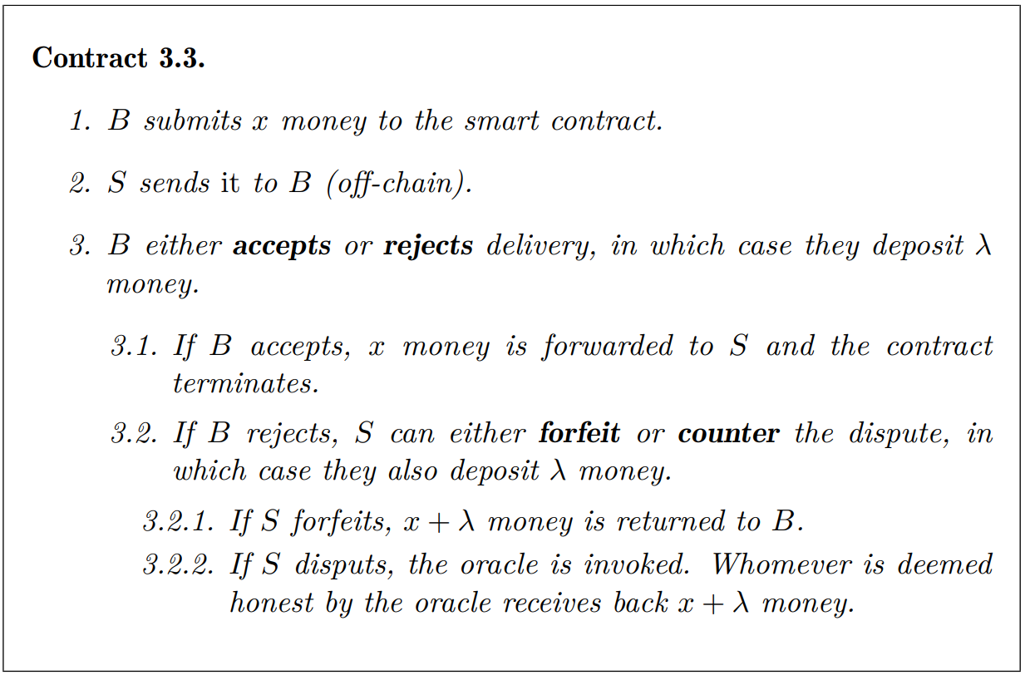
Commerce
ICBC’21
An Incentive-Compatible Smart Contract for Decentralized Commerce
Nikolaj I. Schwartzbach

Slide 18
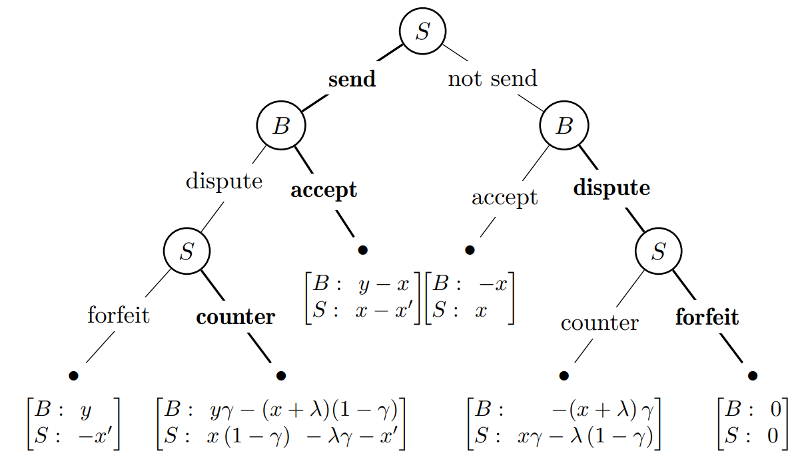
As a Game Tree
ICBC’21
An Incentive-Compatible Smart Contract for Decentralized Commerce
Nikolaj I. Schwartzbach

Slide 19
Main Result
ICBC’21
An Incentive-Compatible Smart Contract for Decentralized Commerce
Nikolaj I. Schwartzbach
Theorem.
If λ = x, then a rational agent should expect to lose
x (1 - 2γ)
money by cheating.
Example: Alice buys a toaster for 100DKK, and the adjudication has an error of 10%. Then she should expect to lose 80DKK by cheating.

Slide 20
Random Coin Flipping
ICBC’21
An Incentive-Compatible Smart Contract for Decentralized Commerce
Nikolaj I. Schwartzbach
Corollary.
Using a random coin toss as the adjudication, honesty is an equilibrium.
Can be implemented under computational assumptions by using a coin tossing protocol (such as [Blum’81]).
In this case, honesty is a computational equilibrium.

Slide 21
A Generalization
ICBC’21
An Incentive-Compatible Smart Contract for Decentralized Commerce
Nikolaj I. Schwartzbach
The contract receives 2λ and pays back λ to the winner.
Suppose instead the contract pays back αλ for some 0 ≤ α ≤ 2.
Then α = 1 is the normal contract.
Theorem.
For an α that satisfies,
1 / (1 - γ) < α ≤ 2,
we can get arbitrarily high security for large enough λ.

Slide 22
Agenda
Blockchains
Commerce
Adjudication
Payments
Commitments

Slide 23
Q:
Can we create a non-trivial system for dispute resolution?
“
”

Slide 24
Adjudication
IJCAI’23
Outsourcing Adjudication to Strategic Jurors
Ioannis Caragiannis and Nikolaj I. Schwartzbach
Alice
WeToast

Slide 25
Payment Functions
IJCAI’23
Outsourcing Adjudication to Strategic Jurors
Ioannis Caragiannis and Nikolaj I. Schwartzbach
Suppose the possible votes are and .
If an agent votes for , and an x-fraction of other agents did the same, we pay the agent p(x).
Q: Which p(x) should we choose?

Slide 26
Payment Functions
IJCAI’23
Outsourcing Adjudication to Strategic Jurors
Ioannis Caragiannis and Nikolaj I. Schwartzbach
Threshold payment.
Give fixed payment to each agent in the majority.
Give nothing to everyone else.
Award/loss sharing.
The minority shares a fixed penalty.
This money is shared among the majority.
Used in practice by Kleros.

Slide 27
Jury Process
IJCAI’23
Outsourcing Adjudication to Strategic Jurors
Ioannis Caragiannis and Nikolaj I. Schwartzbach
Each juror receives some case evidence.
They exert some effort and receive a signal that correlates with the ground truth.
Let λ_{i} be the effort exerted by agent i.
An agent learns the ground truth with probability f_{i} (λ_{i} ).
Agent do not care about the outcome of the case.
May lie about their true opinion.

Slide 28
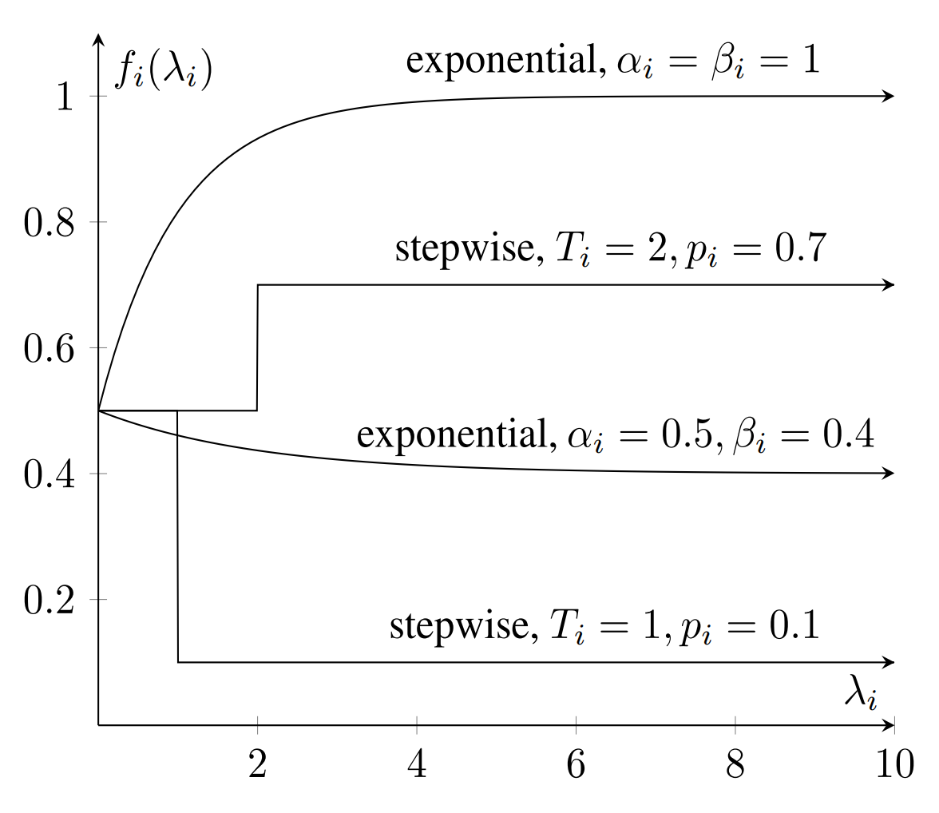
Effort Functions
IJCAI’23
Outsourcing Adjudication to Strategic Jurors
Ioannis Caragiannis and Nikolaj I. Schwartzbach

Slide 29
Equilibrium Analysis
IJCAI’23
Outsourcing Adjudication to Strategic Jurors
Ioannis Caragiannis and Nikolaj I. Schwartzbach
Theorem.
At equilibrium, an agent will,
vote randomly if their opinion is uncorrelated with the
final outcome;
otherwise, they will exert some effort; and,
vote according to their belief if the correlation is positive
vote against their belief if the correlation is negative

Slide 30
Structure of Equilibria
IJCAI’23
Outsourcing Adjudication to Strategic Jurors
Ioannis Caragiannis and Nikolaj I. Schwartzbach
Corollary.
The trivial strategy where all agents vote randomly is always an equilibrium.
Corollary.
All non-trivial equilibrium come in pairs where,
one equilibrium is good.
one equilibrium is bad.

Slide 31
Simulation Experiments
IJCAI’23
Outsourcing Adjudication to Strategic Jurors
Ioannis Caragiannis and Nikolaj I. Schwartzbach
We want to argue that, in practice, the jurors would tend to reach the good equilibrium.
Simulate the jury process:
In the first round, each agent exerts small amount of effort, and vote according to their belief.
In each subsequent round, an agent learns the number of correct votes in previous round and responds strategically.

Slide 32
Results
IJCAI’23
Outsourcing Adjudication to Strategic Jurors
Ioannis Caragiannis and Nikolaj I. Schwartzbach

Slide 33
Conclusion
IJCAI’23
Outsourcing Adjudication to Strategic Jurors
Ioannis Caragiannis and Nikolaj I. Schwartzbach
The adjudication mechanism works under reasonable assumptions:
The agents are rational.
Most agents are well-informed.
Designing good payments functions requires a lot more work.
Implies the contract for commerce is secure in a strong sense!

Slide 34
Agenda
Blockchains
Commerce
Adjudication
Payments
Commitments

Slide 35
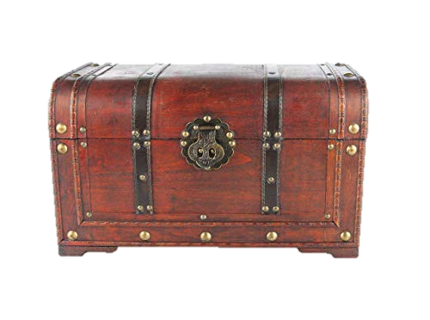

Slide 36
Q:
Can we use smart contracts to make
other interactions secure?
“
”

Slide 37
EC’22
Payment Schemes from Limited Information with Applications in Distributed Computing
Nikolaj I. Schwartzbach

Slide 38
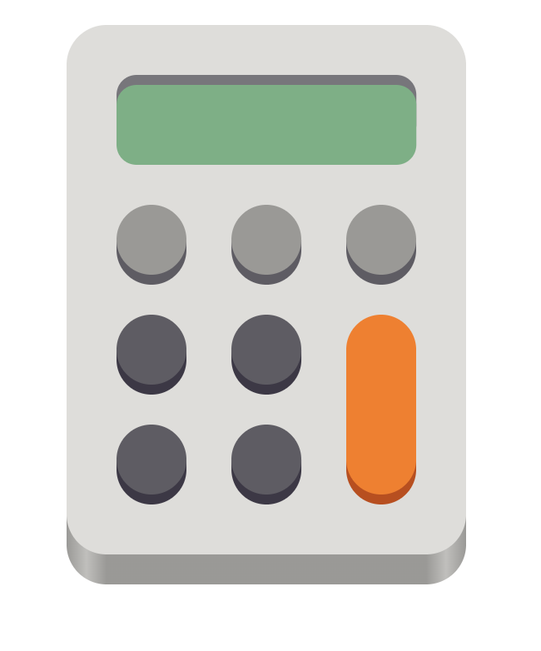
EC’22
Payment Schemes from Limited Information with Applications in Distributed Computing
Nikolaj I. Schwartzbach
i
j
k
k
k
k
j

Slide 39
Information Structure
EC’22
Payment Schemes from Limited Information with Applications in Distributed Computing
Nikolaj I. Schwartzbach
Consider an n-player game with m possible outcomes.
Let U ∈ ℝ^{m x n} be the utility matrix of the game.
Definition.
An information structure is a matrix
Φ ∈ ℝ^{s} ^{x m}
that for each of the m leafs of the game specifies a distribution (pdf) on some alphabet of s observable outcomes.

Slide 40
Payment Scheme
EC’22
Payment Schemes from Limited Information with Applications in Distributed Computing
Nikolaj I. Schwartzbach
Let U ∈ ℝ^{m x n} be the utility matrix of some game.
Let Φ ∈ ℝ^{s} ^{x m} be an information structure.
Definition.
A payment scheme is a matrix
Λ ∈ ℝ^{n} ^{x s}
that for each of the s symbols, gives a payment for each of the n players.

Slide 41
Induced Game
EC’22
Payment Schemes from Limited Information with Applications in Distributed Computing
Nikolaj I. Schwartzbach
Let U ∈ R^{m x n} be the utility matrix of some game.
Let Φ ∈ R^{s} ^{x m} be an information structure.
Let Λ ∈ R^{n} ^{x s} be a payment scheme.
Then the expected utility for player i in leaf j is
[U – ΛΦ]_{ij}
Q: how do we find Λ such that E = U – ΛΦ has desirable properties?

Slide 42
Main Results
EC’22
Payment Schemes from Limited Information with Applications in Distributed Computing
Nikolaj I. Schwartzbach
Theorem.
Finding a minimal set of budget balanced payments for games of perfect information is P-complete.
Theorem.
Any function f can be computed with ε-security by augmenting a δ-deterrent PVC protocol with payments of size O(1 + ε/δ).
Theorem.
To get ε-security, the largest payment in a budget balanced payment scheme must be at least Ω(1 + ε√n / s).

Slide 43
Example: Commerce
EC’22
Payment Schemes from Limited Information with Applications in Distributed Computing
Nikolaj I. Schwartzbach
send
not send
not send
reject
accept
accept
reject
reject
reject
U
: x-x’
: -x’
: 0
: x
: y-x
: y
: 0
: -x

Slide 44
Example: Commerce
EC’22
Payment Schemes from Limited Information with Applications in Distributed Computing
Nikolaj I. Schwartzbach
send
not send
accept
reject
reject
accept
E
: x-x’
: -x’
: -x’
: x
: y-x
: y – 2x
: 0
: -x

Slide 45
Example: Commerce
EC’22
Payment Schemes from Limited Information with Applications in Distributed Computing
Nikolaj I. Schwartzbach
Suppose we have a noisy adjudication mechanism with an error rate of γ. Then we get the following information structure:
1 0 0 1
Φ ⁼ 0 γ 1-γ 0
0 1-γ γ 0
(
)
everything fine
cheated
cheated

Slide 46
Example: Commerce
EC’22
Payment Schemes from Limited Information with Applications in Distributed Computing
Nikolaj I. Schwartzbach
To find suitable payment scheme, find Λ s.t. ΛΦ = U – E.
For our setting, there is a solution:
Λ =
(
)
0 x’ (1-γ)/(1-2γ) -x’ γ/(1-2γ)
0 -2x γ/(1-2γ) 2x (1-γ)/(1-2γ)
everything fine
cheated
cheated

Slide 47
Example: Commerce
EC’22
Payment Schemes from Limited Information with Applications in Distributed Computing
Nikolaj I. Schwartzbach
For concreteness, let
x = 100DKK x’ = 50DKK γ = 10%
Then the buyer must make a deposit of size 225DKK, while the seller makes a deposit of size 57DKK
Results in 100DKK-secure commerce .

Slide 48
Agenda
Blockchains
Commerce
Adjudication
Payments
Commitments

Slide 49
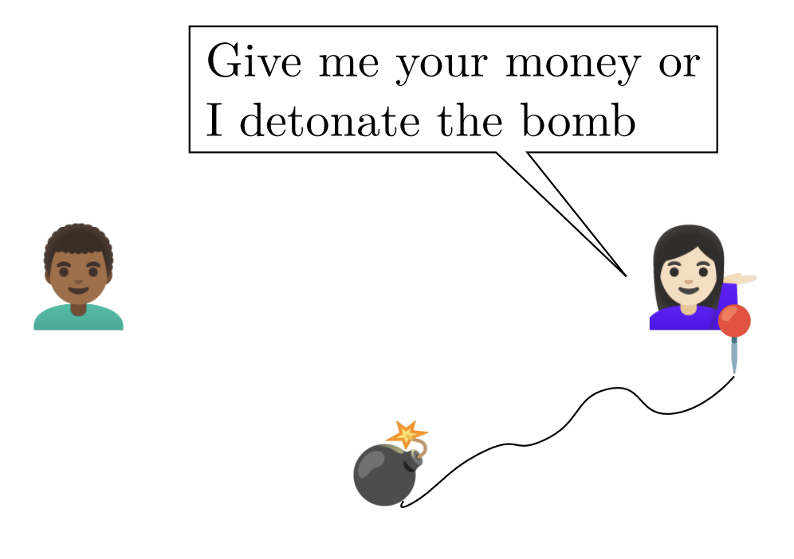
SAGT’21
Game Theory on the Blockchain: A Model for Games with Smart Contracts
Mathias Hall-Andersen and Nikolaj I. Schwartzbach
Bob
Alice

Slide 50
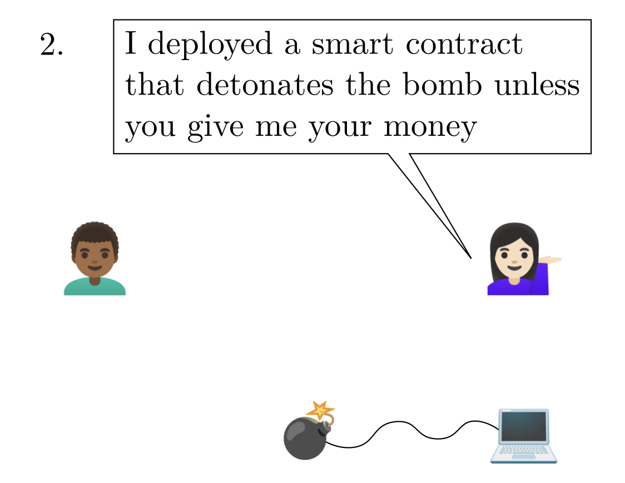
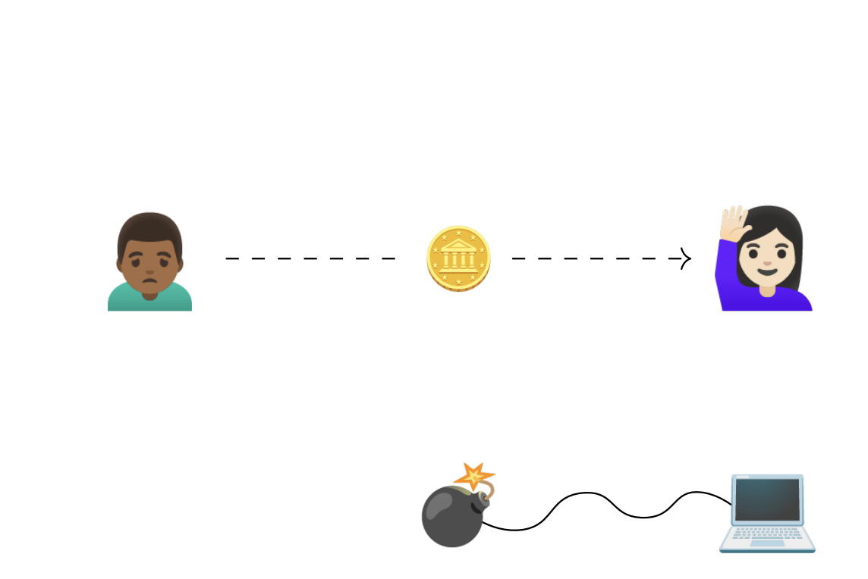
SAGT’21
Game Theory on the Blockchain: A Model for Games with Smart Contracts
Mathias Hall-Andersen and Nikolaj I. Schwartzbach
Bob
Alice

Slide 51
SAGT’21
Game Theory on the Blockchain: A Model for Games with Smart Contracts
Mathias Hall-Andersen and Nikolaj I. Schwartzbach
=
: -
: -
: -
: -
: +
: +
: +
: +
: -∞
: 0
: -∞
: 0
: 0
: -∞
: +∞
: 0
: +∞
: 0
: 0
: +∞

Slide 52
Complexity Results
SAGT’21
Game Theory on the Blockchain: A Model for Games with Smart Contracts
Mathias Hall-Andersen and Nikolaj I. Schwartzbach
Theorem.
Computing an SPE in a game with k contracts is Σ_{k}^{P}-hard.
Theorem.
Computing an SPE in a game of perfect information with two contracts takes O(m ²) time.
Theorem.
Computing an SPE in games (even with perfect information) is PSPACE-hard for O(m ) contracts.

Slide 53
Stackelberg Equilibria
SAGT’21
Game Theory on the Blockchain: A Model for Games with Smart Contracts
Mathias Hall-Andersen and Nikolaj I. Schwartzbach
Theorem.
Stackelberg equilibria correspond to the special case with one contract.
Theorem.
Reverse Stackelberg equilibria correspond to the special case with two contracts.

Slide 54
Q:
Which games remain secure when
the agents can deploy contracts?
“
”

Slide 55
Stackelberg Resilience
Preprint
Stackelberg Attacks or: How I Learned to Stop Worrying and Trust the Blockchain
Daji Landis and Nikolaj I. Schwartzbach
We say a game is Stackelberg k-resilient if its equilibrium is unchanged by the addition of k contracts.
Corollary.
Stackelberg 1-resilience is NP-hard to compute.
Corollary.
Stackelberg 2-resilience can be computed in quadratic time for games of perfect information.

Slide 56
Stackelberg Resilience
Preprint
Stackelberg Attacks or: How I Learned to Stop Worrying and Trust the Blockchain
Daji Landis and Nikolaj I. Schwartzbach
Theorem.
The commerce contract is full Stackelberg resilient.
Theorem.
If a game is not (k -1)-resilient, it is also not k -resilient.

Slide 57
Transaction Fee Mechanisms
ECAI’23
Stackelberg Attacks on Auctions and Blockchain Transaction Fee Mechanisms
Daji Landis and Nikolaj I. Schwartzbach

Slide 58
A Stackelberg Attack
ECAI’23
Stackelberg Attacks on Auctions and Blockchain Transaction Fee Mechanisms
Daji Landis and Nikolaj I. Schwartzbach
If you commit to bidding ε,
I will bid 2ε; otherwise, I
will make my original bid.

Slide 59
Feasibility of Attack
ECAI’23
Stackelberg Attacks on Auctions and Blockchain Transaction Fee Mechanisms
Daji Landis and Nikolaj I. Schwartzbach
Theorem.
Let v₁ < v₂ < … < v_{n} be the valuations of the n agents, and let m be the size of the block, and n > m.
If for some k < m, it holds that,
v_{n-k+1} n - k
v_{n-m} n – m
then transaction fee mechanisms are not Stackelberg resilient.
(holds for first-price, second-price, and for EIP-1559)
<

Slide 60
Works for Natural Distributions
ECAI’23
Stackelberg Attacks on Auctions and Blockchain Transaction Fee Mechanisms
Daji Landis and Nikolaj I. Schwartzbach
Theorem.
Let n = (1 + α) m, where α > 0 is a congestion constant.
Then the conditions required for the attack to hold are satisfied with overwhelming probability if either:
The valuations are sampled i.i.d. from a uniform distribution and 0 < α < 0.53.
The valuations are sampled i.i.d. from a Pareto distribution with parameter p > 1, and 0 < α < α(p), for some α(p) with 0 < α(p) < 0.69.

Slide 61
Everyone Benefits Except for the Miner
ECAI’23
Stackelberg Attacks on Auctions and Blockchain Transaction Fee Mechanisms
Daji Landis and Nikolaj I. Schwartzbach
Theorem.
Let n = (1 + α) m, where α > 0 is a congestion constant.
Let u be the utility an agent gets in the normal auction, and let u’ be the utility an agent gets in the attack.
Then with overwhelming probability, it holds that,
u’ / u > 1 + α – o(1)

Slide 62
Conclusion
We propose a system for fully decentralized commerce that provably works under reasonable and minimal assumptions.
We give a number of tools and methods to analyze smart contracts.
More work is needed before these system can (and should) be used.

Slide 63
Thank you.

